Slide 1
HEALTHCURE
(an all in one medical solution)

Slide 2
Objective
In the today’s world we all know that how AI is proving itself to be a hero in the field of medical science. AI has brought a revolution in the field of medical science and is going beyond our imaginations day by day. AI is transforming the practice of medicine. It’s helping doctors diagnose patients more accurately, make predictions about patients’ future health, and recommend better treatments.
From as basic as Diabetes detection or Breast Cancer detection using simple Machine learning models to as complex as Corona virus detection or Brain tumor detection using segmentation and other advanced techniques, AI has gone beyond our imaginations.
That’s why we came with the idea of creating an online platform where we brought together all of these disease detections under the one roof. It contains both simple and advanced type of detections and uses almost every aspect of Machine Learning including Deep Learning.

Slide 3
Overview
Recently the time has been difficult for all of us and every second person around is suffering from one or the other disease, that’s why we tried to bring everything under one platform.
The main advantage of this project is that we can get the test results immediately at our home with a just few clicks.
We are not saying that these results are perfect but yet an experiment we did, which can prove to be a revolution in the coming years.
We know the future is all about AI so here we present our idea of bringing 7 disease detections under one platform using the power of AI.

Slide 4
7 disease detections:
Covid-19 detection
Brain Tumour detection
Breast Cancer detection
Alzheimer detection
Diabetes detection
Pneumonia detection
Heart disease detection

Slide 5
Requirements
Software:
Python (version 3.6 or higher)
Anaconda (for various python libraries)
Tensorflow-gpu
Flask
OpenCV
Hardware:
Laptop

Slide 6
Convolutional Neural Networks
A Convolutional Neural Network (ConvNet/CNN) is a Deep Learning algorithm which can take in an input image, assign importance (learnable weights and biases) to various aspects/objects in the image and be able to differentiate one from the other.
The pre-processing required in a ConvNet is much lower as compared to other classification algorithms. While in primitive methods filters are hand-engineered, with enough training, ConvNets have the ability to learn these filters/characteristics.
The architecture of a ConvNet is analogous to that of the connectivity pattern of Neurons in the Human Brain and was inspired by the organization of the Visual Cortex.
A ConvNet is able to successfully capture the Spatial and Temporal dependencies in an image through the application of relevant filters.
The role of the ConvNet is to reduce the images into a form which is easier to process, without losing features which are critical for getting a good prediction.

Slide 7


Slide 8
Covid-19 Detection
Covid 19 affects different people in different ways.
Most infected people will develop mild to moderate illness and recover without hospitalization.
Most Common Symptoms:
Fever
Dry cough
Tiredness
Less Common Symptoms:
Aches and pains
Sore throat
Diarrhea
Conjunctivitis
Headache
Loss of taste or smell

Slide 9
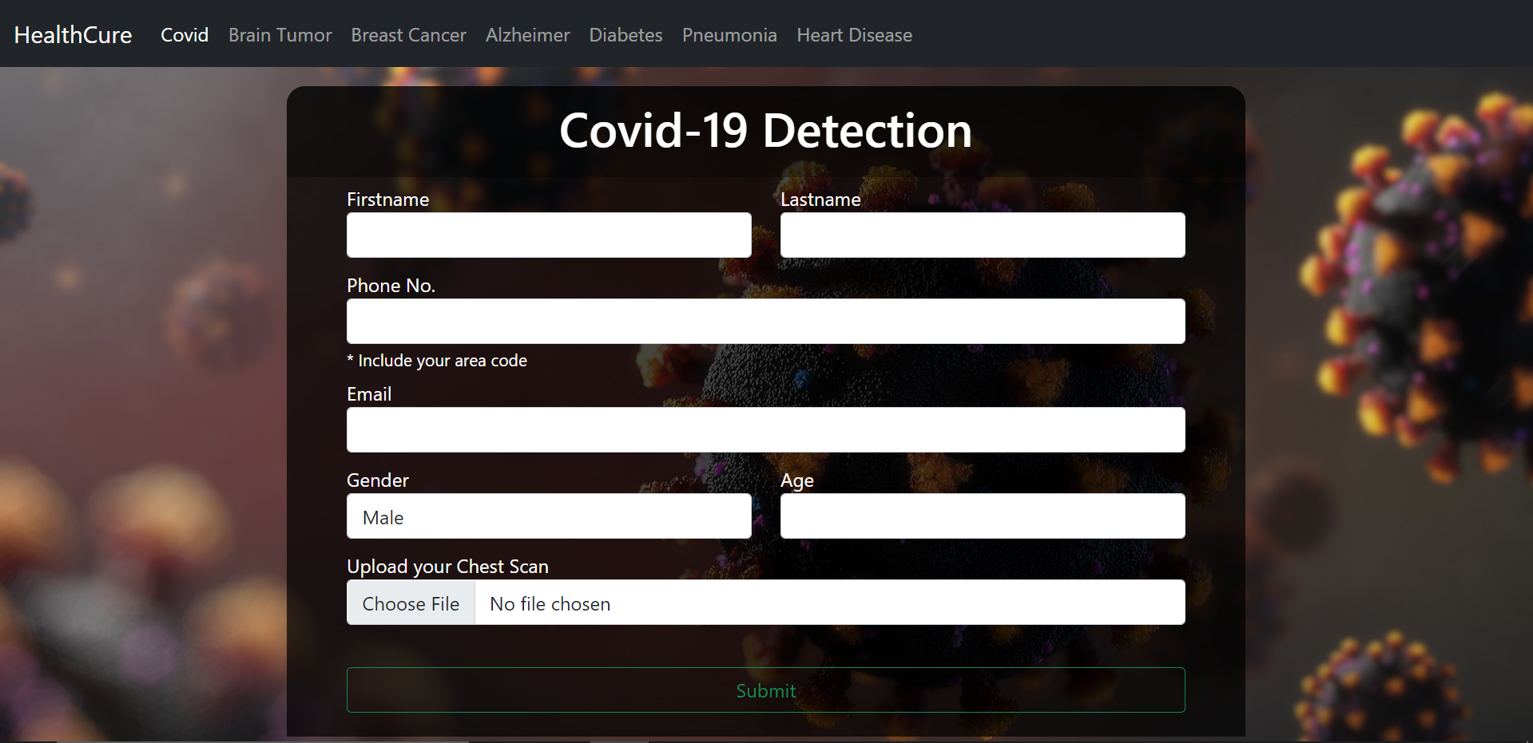

Slide 10
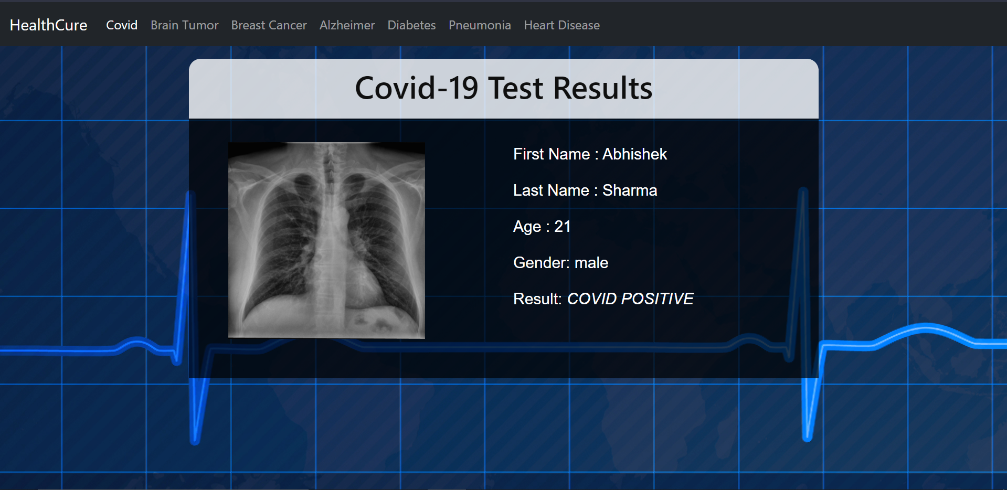

Slide 11
Brain Tumour Detection
Brain tumors can be cancerous (malignant) or noncancerous (benign).
Tumors can start in the brain, or cancer elsewhere in the body can spread to the brain.
When benign or malignant tumors grow, they can cause the pressure inside your skull to increase. This can cause brain damage, and it can be life-threatening.
Symptoms are:
new or increasingly strong Headaches
blurred vision
loss of balance
confusion and seizures
in some cases, there may be no symptoms.

Slide 12
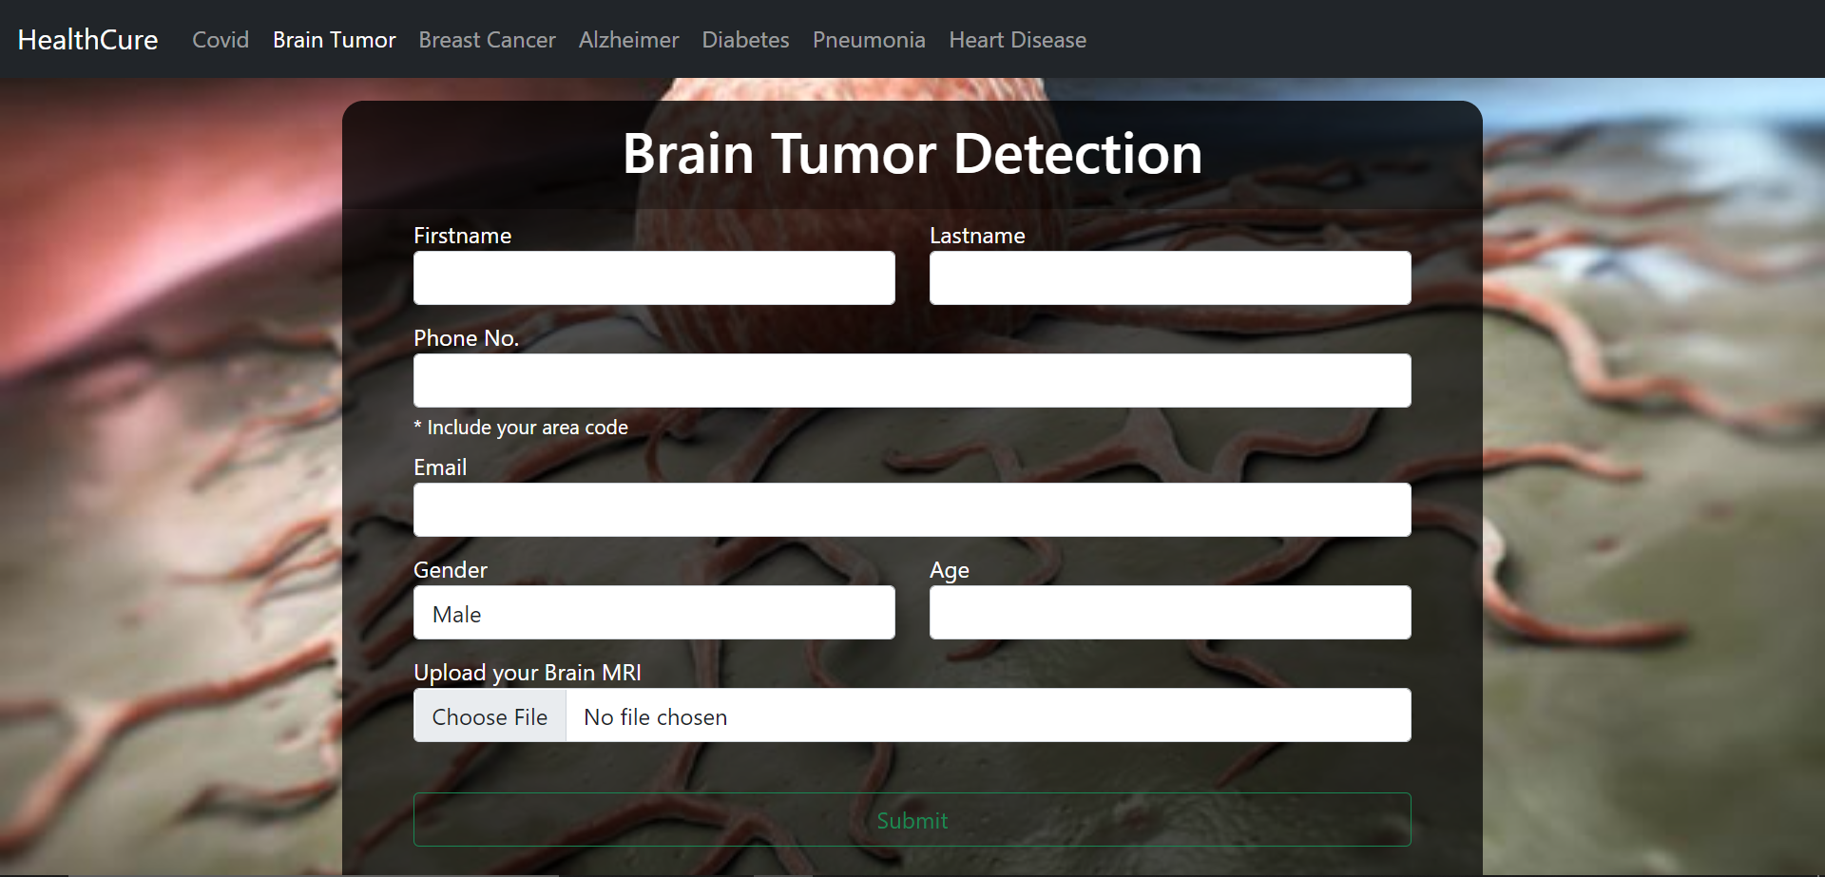

Slide 13
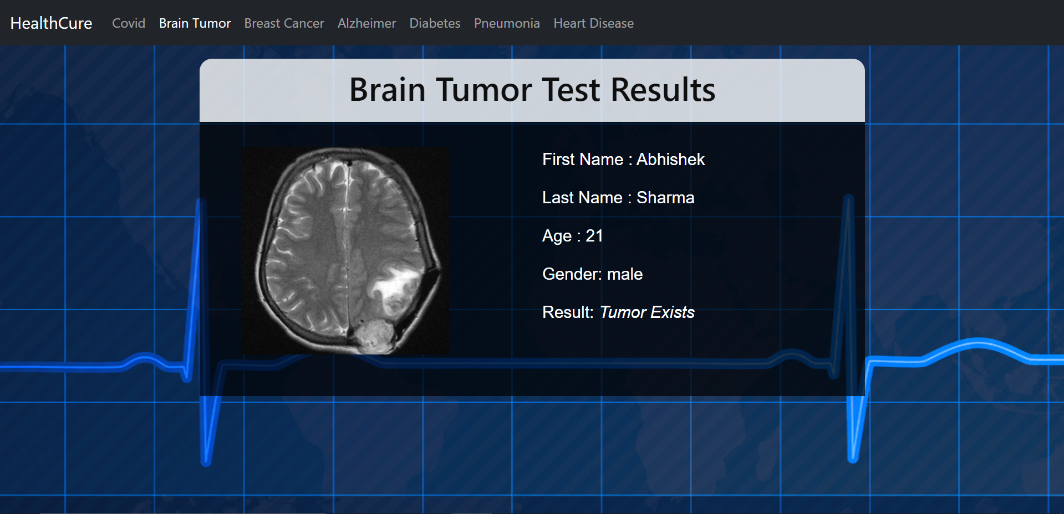

Slide 14
Breast Cancer Detection
Cancer that forms in the cells of the breast .
Breast Cancer can occur in women and rarely in men.
Breast cancer survival rates have increased, and the number of deaths associated with this disease is steadily declining, largely due to factors such as earlier detection, a new personalized approach to treatment and a better understanding of the disease.
Symptoms of Breast Cancer:
a lump in the breast
bloody discharge from the nipple
changes in the shape or texture of nipple or breast.
redness or pitting of the skin over your breast, like the skin of an orange

Slide 15
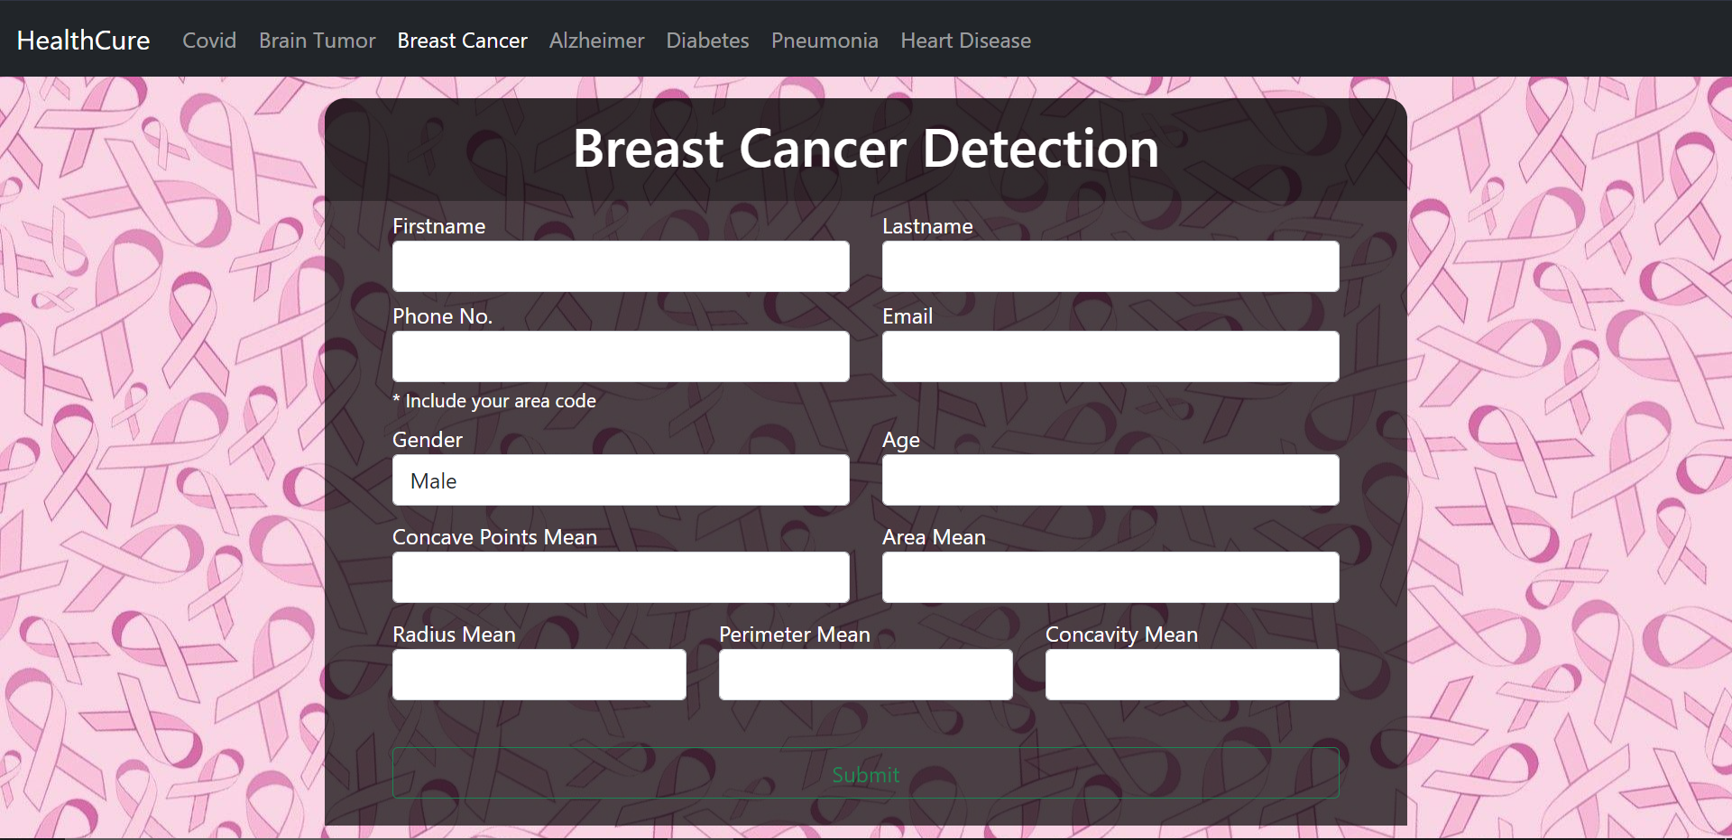

Slide 16
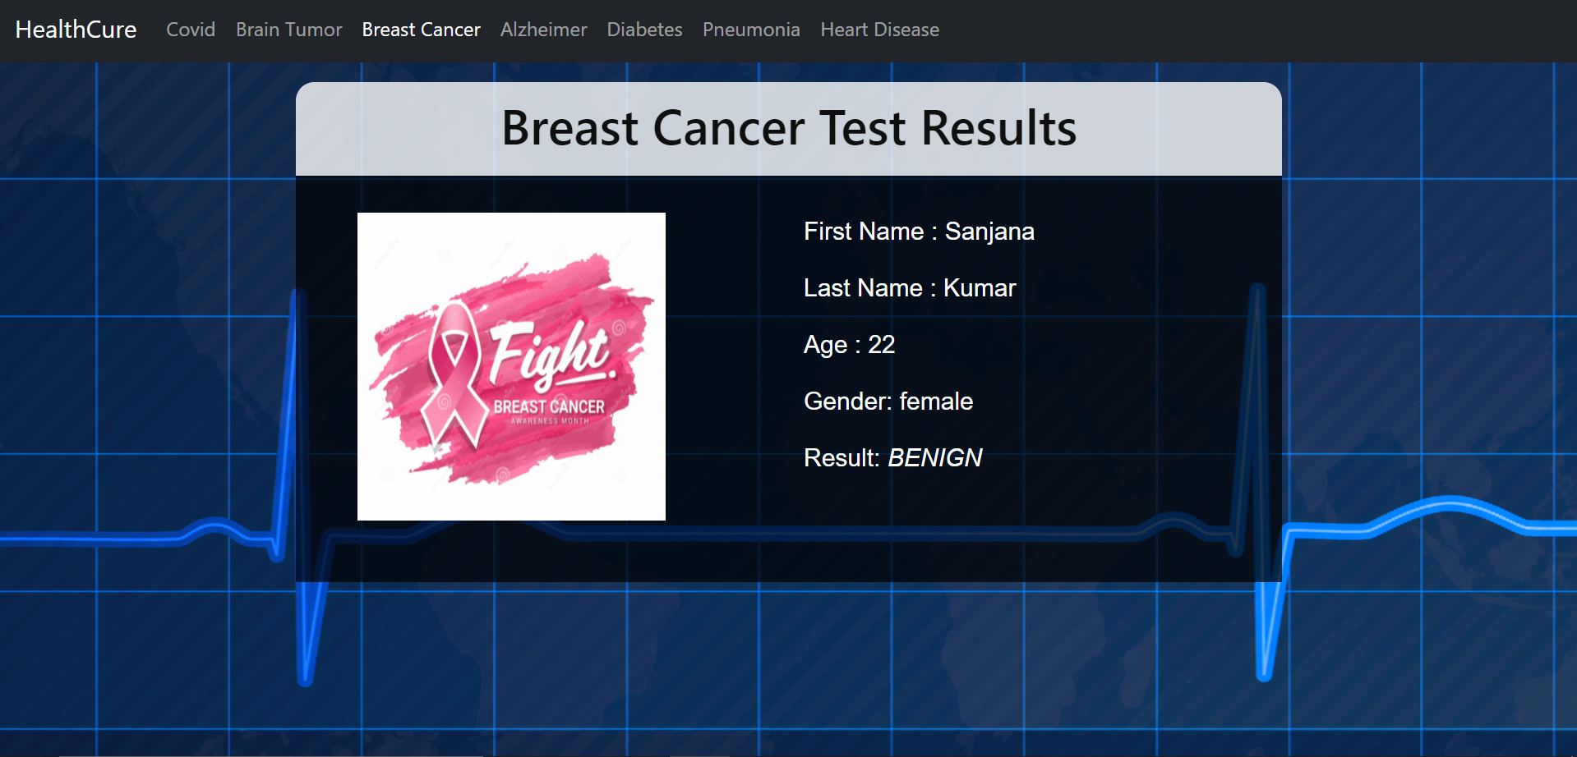

Slide 17
Alzheimer Detection
Progressive disease that destroys memory and other important mental functions.
Brain Cell connections and the cell themselves degenerate and die, eventually destroying memory and other important mental functions.
Memory loss is the key symptom of Alzheimer disease .
Early signs include difficulty in remembering recent events or conversations.
As the disease progress memory impairments worsen and other symptoms develop.
There is no treatment that cures Alzheimer's disease or alters the disease process in the brain.

Slide 18
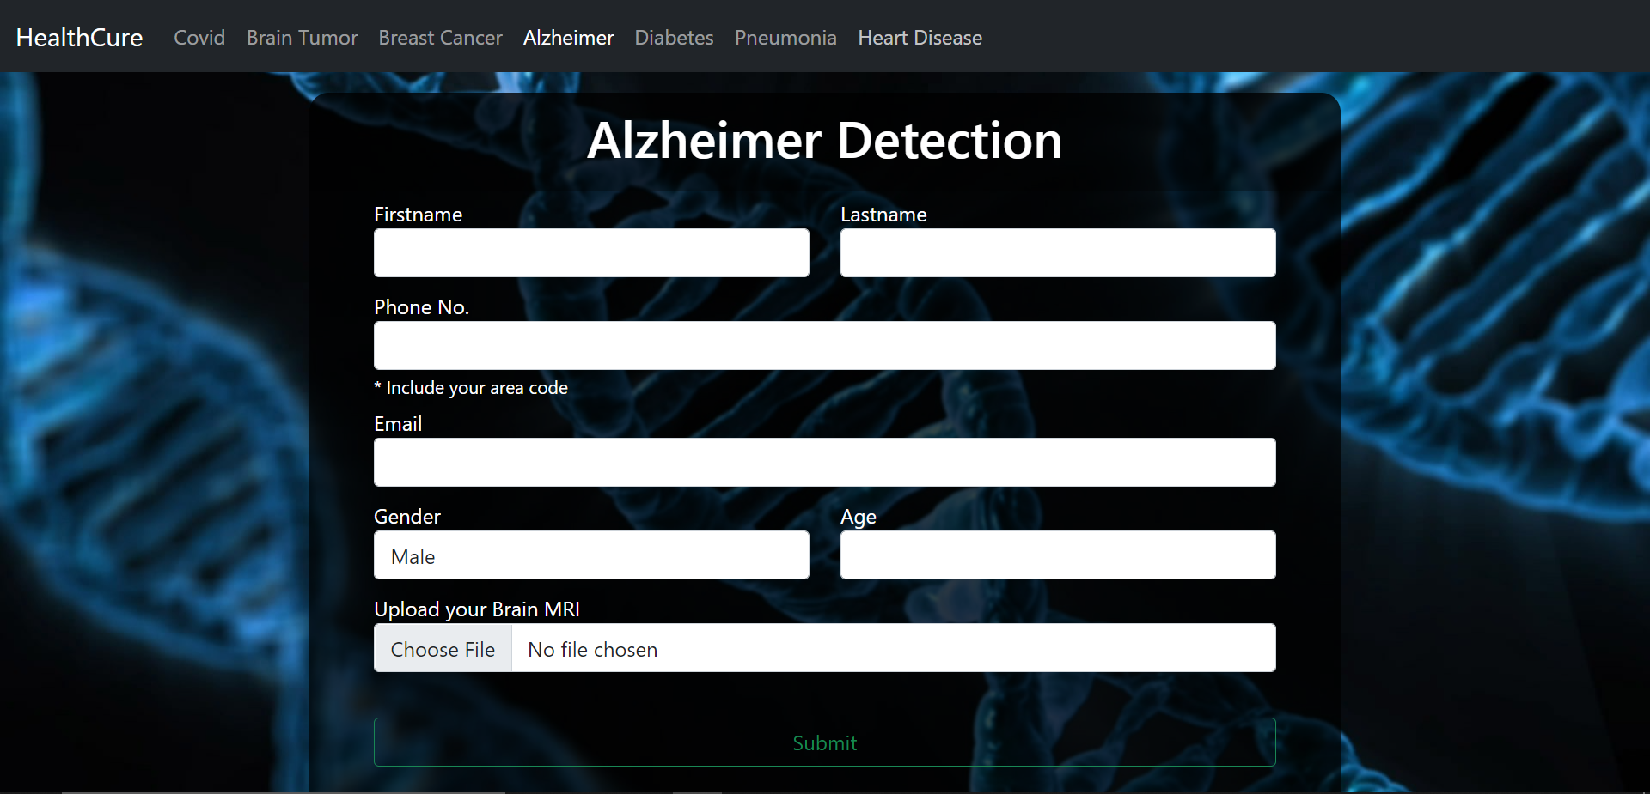

Slide 19
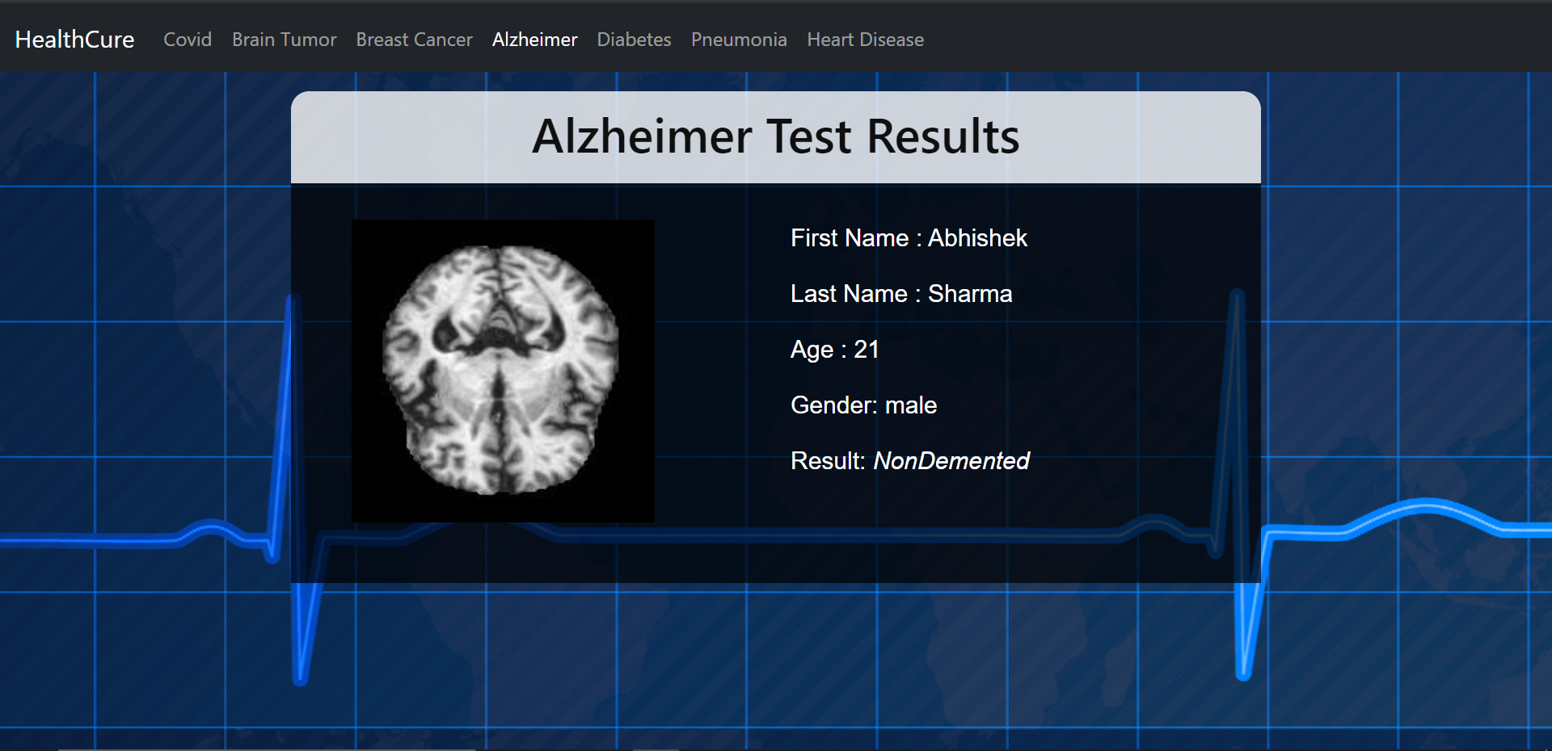

Slide 20
Diabetes Detection
Diabetes is a disease that occurs when your blood glucose, also called blood sugar, is too high.
Also known as blood sugar.
Symptoms include:
increased thirst
frequent urination
hunger
fatigue
blurred vision
In some cases , there may be no symptoms.
Although diabetes has no cure, you can take steps to manage your diabetes and stay healthy.

Slide 21
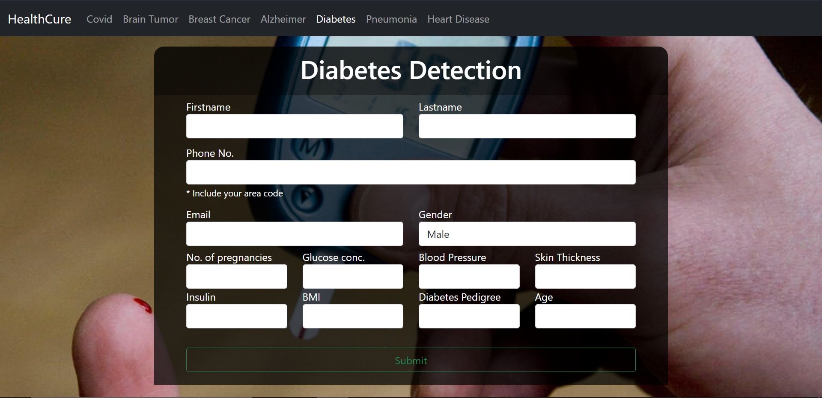

Slide 22
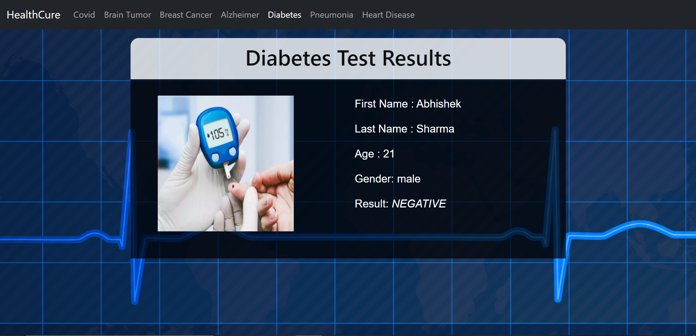

Slide 23
Pneumonia Detection
Infection that inflames air sacs in one or both lungs which may fill with fluids.
With pneumonia the air sacs may fill with fluid or pus.
It is most serious for infants and young children, people older than age 65, and people with health problems or weakened immune systems.
Symptoms of pneumonia:
Coughing that may produce phlegm.
Fever
Shortness of breath
Sweating or chills
Nausea or vomiting
Loss of appetite

Slide 24
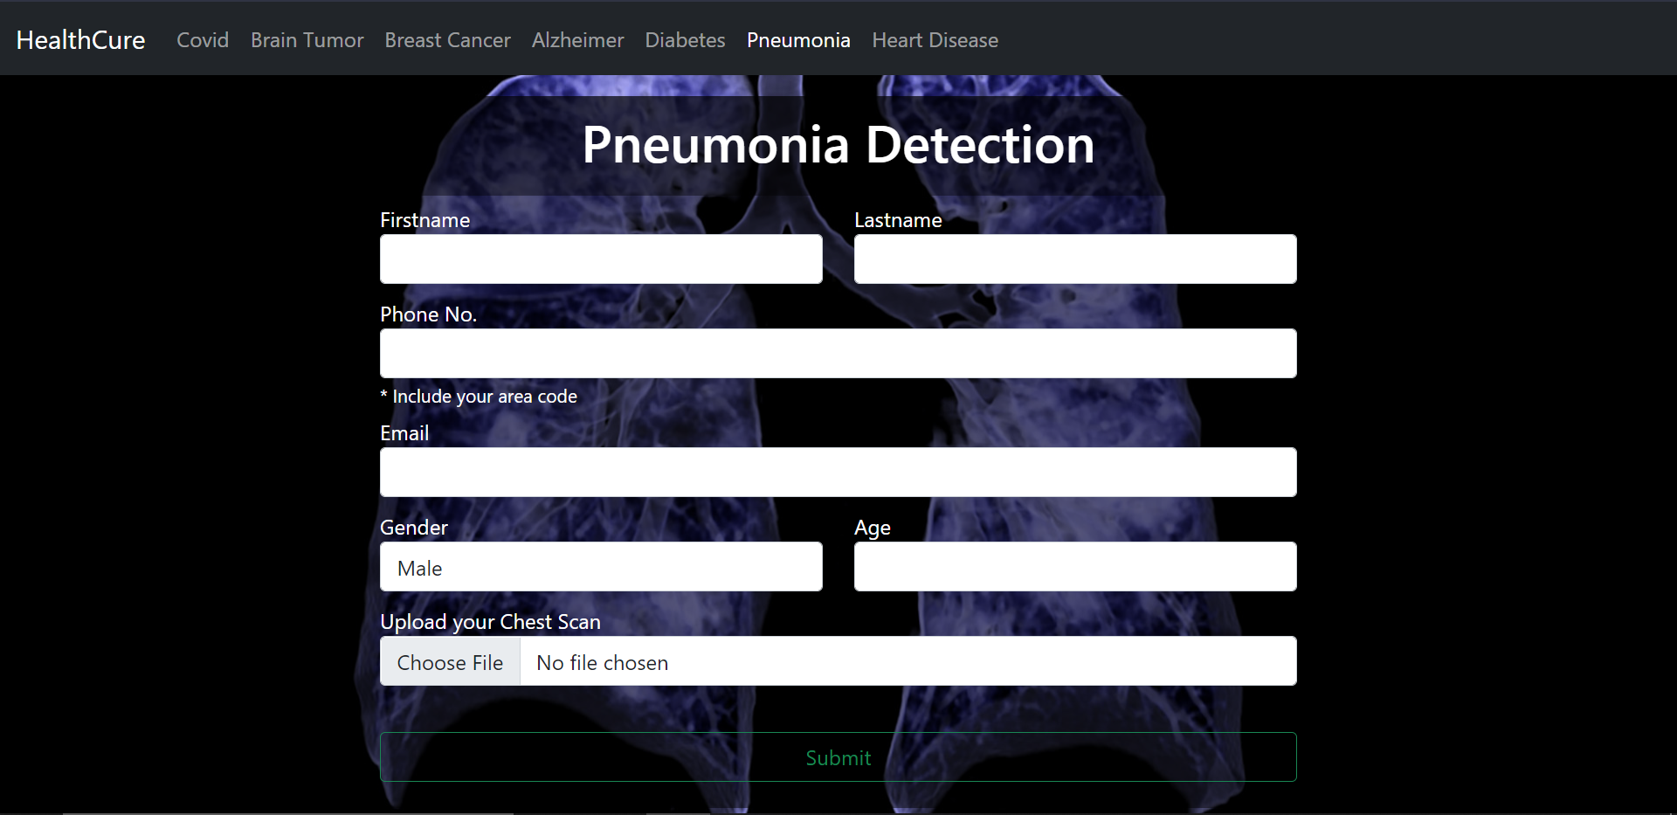

Slide 25
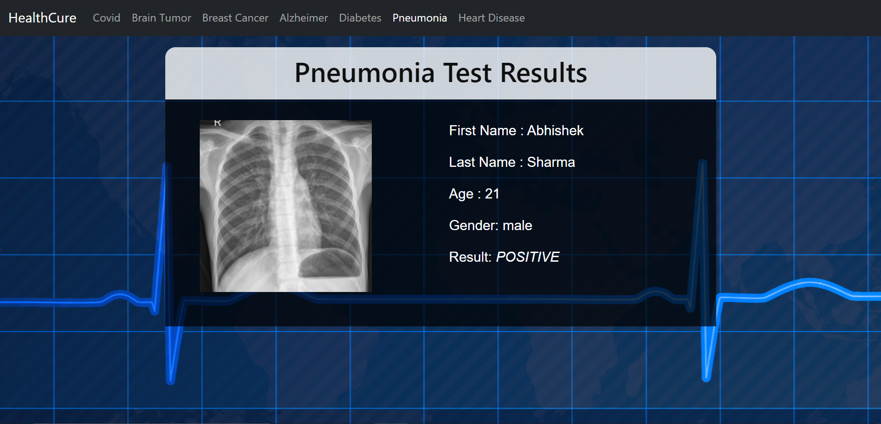

Slide 26
Heart Disease Detection
Heart disease refers to any conditions affecting the heart.
Heart disease describes a range of conditions that affect your heart. Heart diseases include:
Blood vessel disease, such as coronary artery disease
Heart rhythm problems (arrhythmias)
Heart defects you're born with (congenital heart defects)
Heart valve disease
Disease of the heart muscle
Heart infection
Signs and symptoms can include:
Chest pain, chest tightness, chest pressure and chest discomfort (angina)
Shortness of breath
Pain, numbness, weakness or coldness in your legs or arms if the blood vessels in those parts of your body are narrowed
Pain in the neck, jaw, throat, upper abdomen or back
Unlike cardio vascular diseases , which includes problem with the entire circulatory system, heart diseases affects only heart.

Slide 27
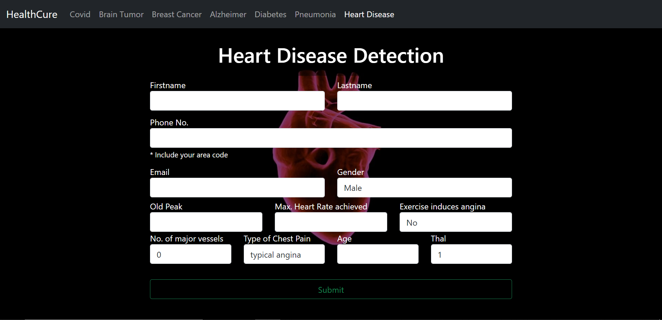

Slide 28
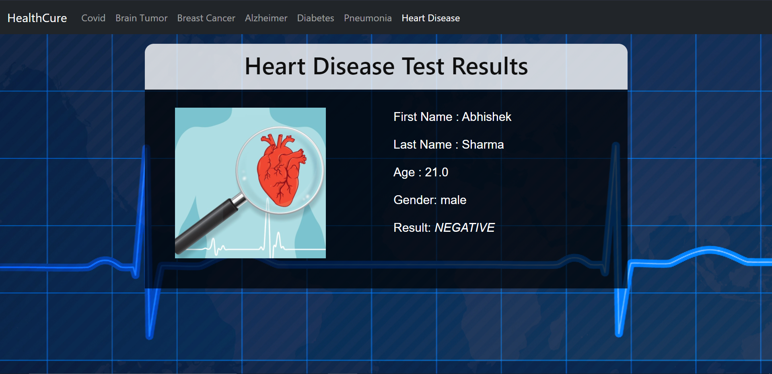

Slide 29
Future Scope
As the time passes, we will be available with more and more data and we will try to make our models even more accurate by training on much more data.
Also we will be adding more disease detections which can be detected using X-ray scans or just by inputting simple numbers.
We are also planning to add more various features like if a person is found positive then our app will show him what precautions does he need to take and how can he cure himself.
We will also be storing the detection records.
So these are some future improvements/additions which we are planning to add.

Slide 30
Challenges
The main challenge that we faced while working on this project was the availability of data (mainly image data).
As we know that data is a big issue in machine learning/deep learning and that's why we had to go on with the amount of data we had.
But we tried our best to take out the best results from what we had.
Yet it was a very challenging task, but we did it.

Slide 31
MEMBERS:
ABHISHEK SHARMA

Slide 32
Thank You !!!

